Slide 1
Mean-Reverting Asset Model in Finance with Jumps
“Lanch at Lab” Presentation
Ouyang, Yuyuan (Lance)
Department of mathematics&statistics
University of Calgary, Alberta

Slide 2
Outline
Introduction
  Energy market
  Mean-reverting models
One-factor Pilipovic model
Two-factor Pilipovic model
Jumps

Slide 3
Energy Market
Difference
  Harder to model
  Stronger mean reversion
  Convenience yield
  Seasonality
  “Split personality”

Slide 4

Mean-Reverting Models
Classical lognormal price model
  Poor in capturing the distribution's tails
Mean-reverting models
  Autocorrelation

Slide 5



Mean-Reverting Models
One factor
  Mean-reverting:

Slide 6


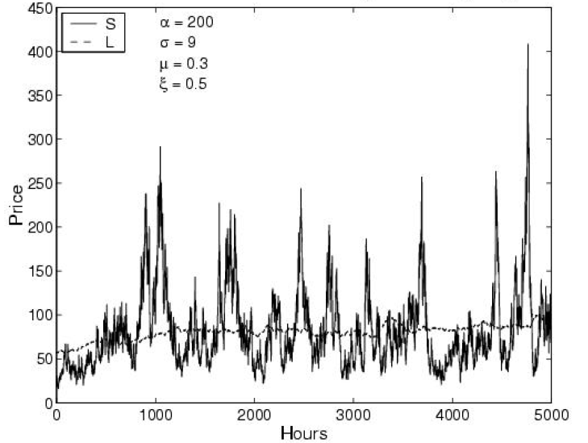
Mean-Reverting Models
Two-factor

Slide 7

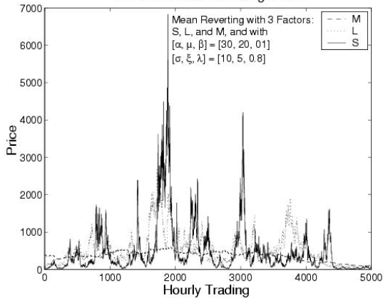
Mean-Reverting Models
Three-factor

Slide 8


One-Factor Pilipovic Model
Explicit solution

Slide 9
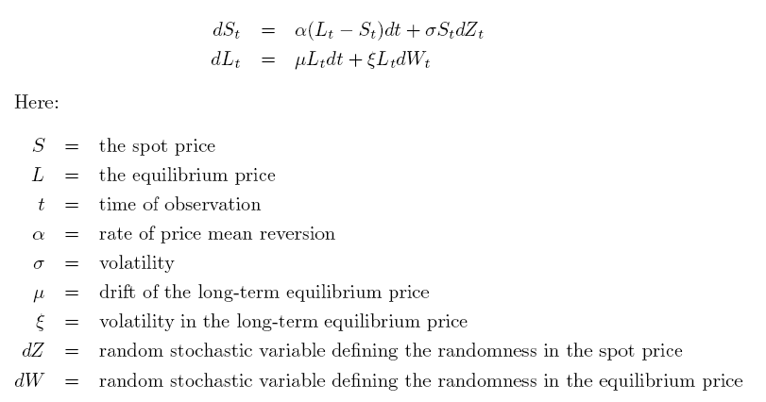
Two-Factor Pilipovic Model

Slide 10


Two-Factor Pilipovic Model
Explicit solution
When , reduce to one-factor Pilipovic model

Slide 11
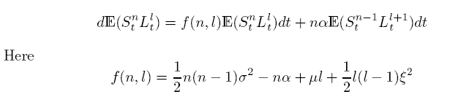
Two-Factor Pilipovic Model
Recurrence differential equation

Slide 12

Two-Factor Pilipovic Model
Moments
  Moments of
  Way to solve
    Start from
    Use the recurrence equation to solve

Slide 13
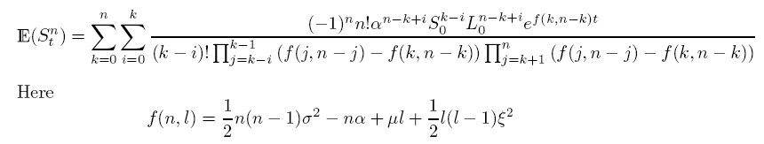

Two-Factor Pilipovic Model
Generalized equation of
Generalized equation of

Slide 14

Two-Factor Pilipovic Model
When the two Wiener process correlated

Slide 15






European Option Pricing Formula
Using one-factor Pilipovic model
:

Slide 16
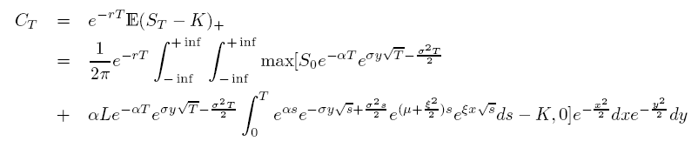
European Option Pricing Formula
Using two-factor Pilipovic model

Slide 17



Jumps
(B, S) securities market with jumps

Slide 18


Jumps
Vasicek model for the interest
  Solution

Slide 19

Jumps
Vasicek model with jumps

Slide 20



Jumps
Cox-Ingersoll-Ross interest rate model
  Solution
  With jumps

Slide 21



Jumps
Generalized interest rate model
  Solution
  With jumps

Slide 22



Jumps
One-factor Pilipovic model with jumps
Two factor Pilipovic model with jumps

Slide 23
Future work
European option pricing formula of two-factor Pilipovic model
One-factor Pilipovic model with jumps

Slide 24
References
Anatoliy Swishchuk (2005), Explicit Option Pricing Formula for a Mean-Reverting Asset
Anatoliy Swishchuk, A. V. Kalemanova (2000), The Stochastic Stability of Interest Rates with Jump Changes
Ali Lari-Lavassani, Ali A. Sadeghi and Tony Ware (2000), Mean Reverting Models for Energy Option Pricing
Dragana Pilipovic (1997), Energy Risk

Slide 25
Thank you
yuyuan@math.ucalgary.ca

